Slide 1
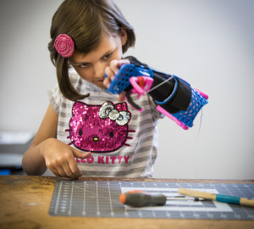


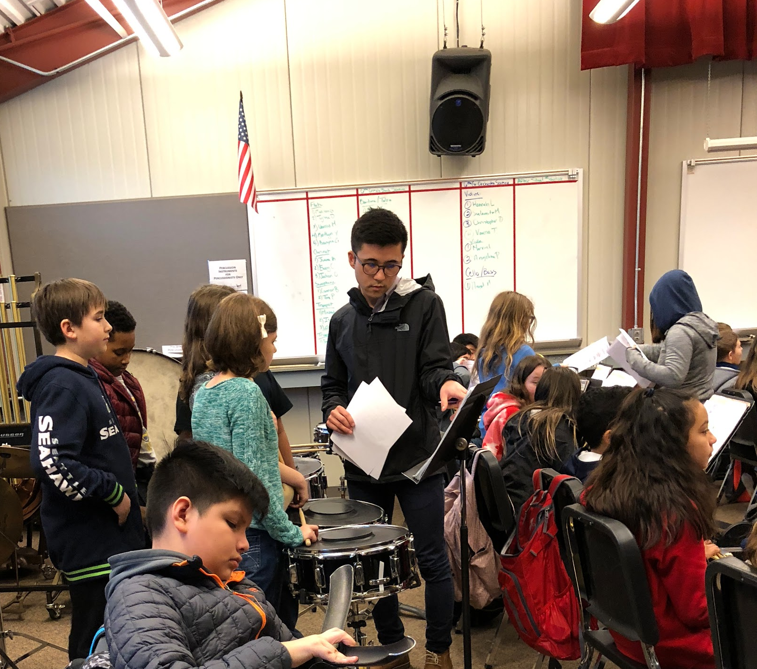
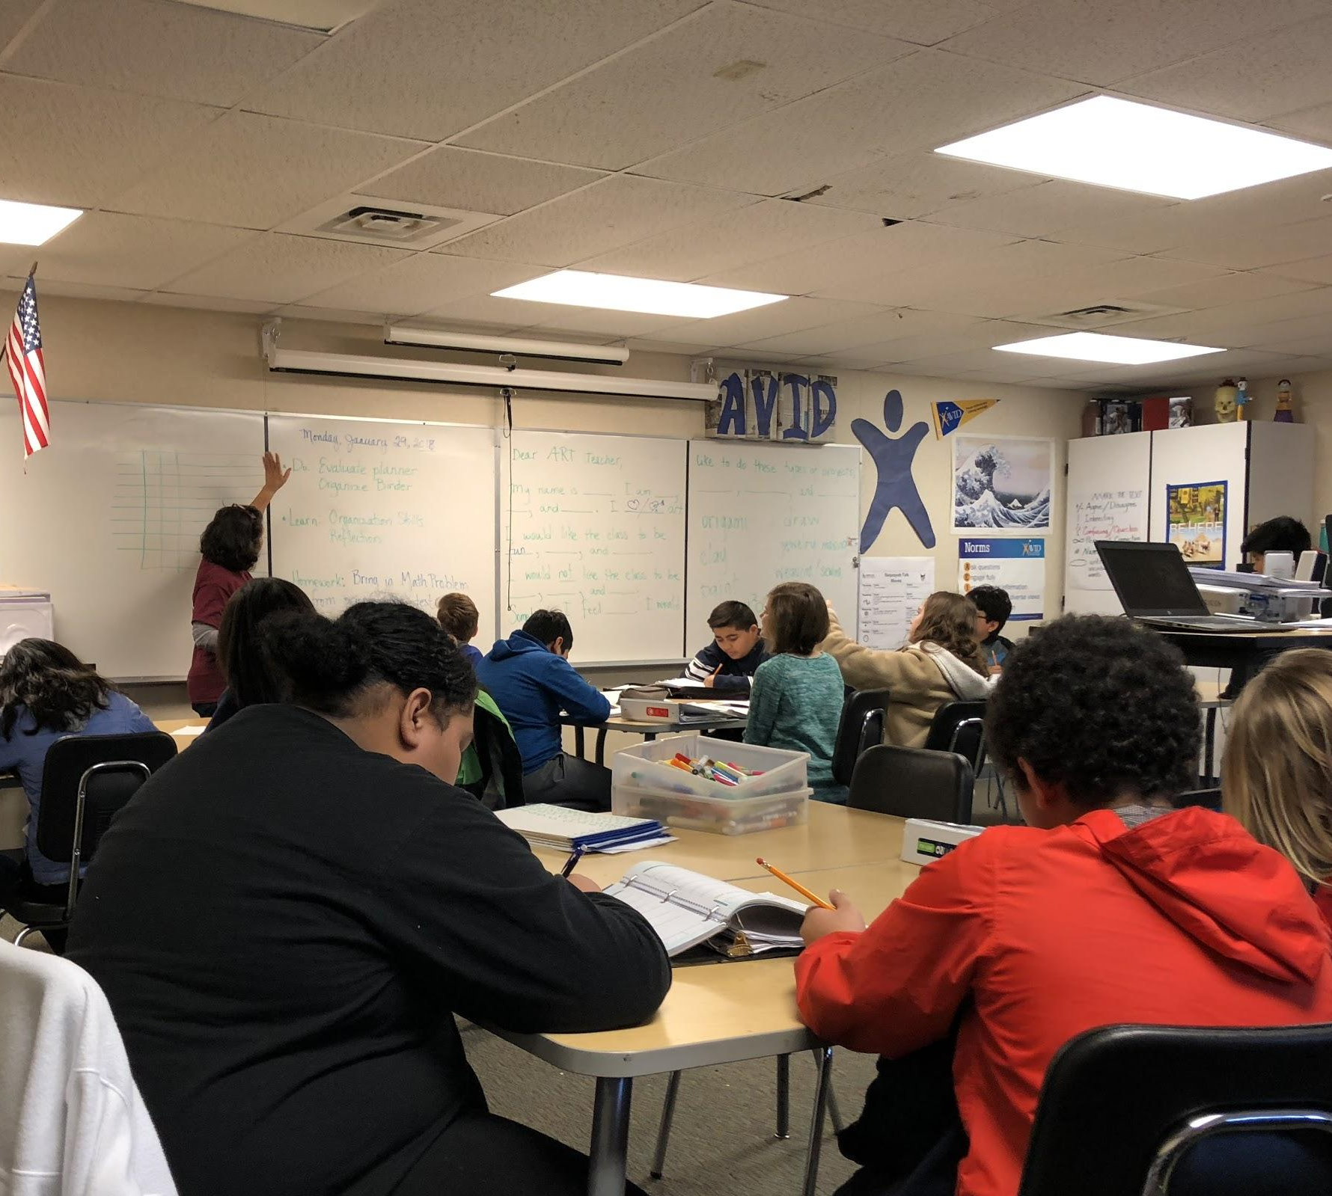
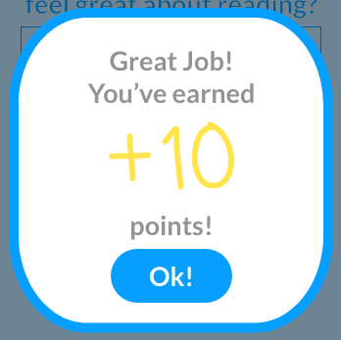
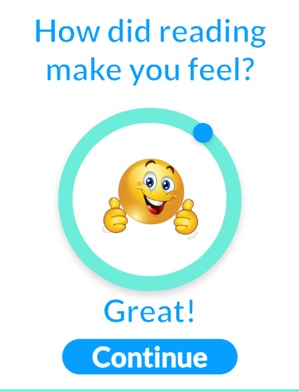
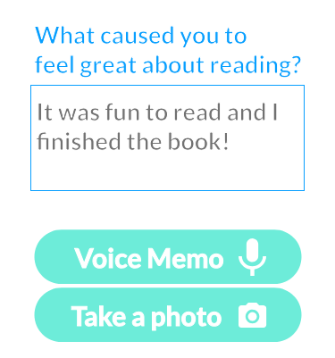
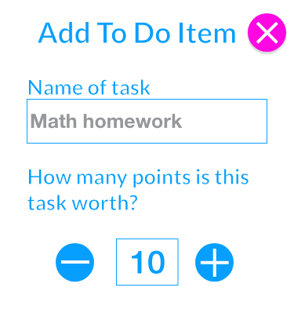



Imagineers : The Day Tracker
Vera Chen, Cheyenne Sokkappa, Swetha Ramaswamy, Anthony Ugas & Jayna
Human Centered Design & Engineering
The Challenge
Complete Tasks
Help Jayna stay on track
Create Tasks
How to help Jayna’s support network stay connected with Jayna, and track her well being?
Reflect
JAYNA
Earn
Points
MOM
Monitor Progress
Create
Rewards
Know how Jayna’s day is progressing
Core Function
Secondary Function
Design Attributes
Constraints
Reminders to do daily tasks
A way to communicate with her support network
Task planner
Take pictures for recording progress
Audio message
Share feature
Reward system
Prioritizing tasks
Colorful & Animated
Big buttons and large text
Intuitive to use
Minimal typing
Audio may not always be appropriate in school
Emotion feedback may not be accurate
Jayna may not have access to her tablet at any time
Design Features: We’d love your feedback!
School Visit
a
Rewards
b
Emotion Tracker
c
Voice Memo
d
To-do List
(Mom’s View)
Next Steps
Build Accessibility features
2. Conduct usability tests to gain feedback
3. Develop and Launch!
Acknowledgements
Dr. Kat Steele for all the helpful instructions.
Dianne G. Hendricks for the inspirational suggestions and feedback.
Jayna and her family for the valuable time and help.
Mathers Fund to Empower and Improve Human Ability for their ongoing support of HuskyADAPT.
Notes:
You can move the headings and sections included in the poster template as you wish. However, your poster should highlight:
The Challenge (use a well polished point of view or need statement, include some description of your need experts, take ample space to make this very clear!)
-- After looking at this section, your audience should have a good idea of what your challenge is AND why it is important!
-- It should be clear from your poster what current solutions include and why they don’t meet your POV
-- Some other sub-sections or sub-headings you might include in this section could be Core Functions (what does your solution need to do to satisfy need), Current Solutions (what exists and why don’t they meet the need), Motivation (add extra emphasis for why this is important), Broader Applications (beyond your need expert, what are the broader impacts or applications of this challenge)
Design Ideas (should be the main focus of poster)
-- This section should highlight your leading 1-3 design ideas
-- Make sure someone can quickly see and describe the main features/innovations of your design by quickly looking at your poster.
-- Remember that the purpose of this design review is to get feedback on your design ideas – what can you put in this section to maximize the amount of useful feedback you can get?
-- Items you might want to highlight include models, sketches, quotes or initial feedback you’ve received, initial prototypes
-- Highlight how your design idea is unique and meets the challenge you outlined above
Next Steps (Where are you headed? What is your goal by the end of next quarter?)
Use this as an opportunity to use positive language and focus on the abilities and expertise of your need experts!
Consider how you will interact with and use the poster as a backdrop to share your design with others. What other props or interactive activities do you want to bring?
Keep text to a minimum (use bullets and lists). Make sure all text is large enough to be read from a distance of 2 meter, nothing smaller than 36 pt font.
Use images, graphs, and tables instead of text whenever possible.
We will print the posters – please do not change the overall size of the poster.

